Slide 1

Introduction to
Dr. Vishwanath Rao

Slide 2

Why git is useful?

Slide 3
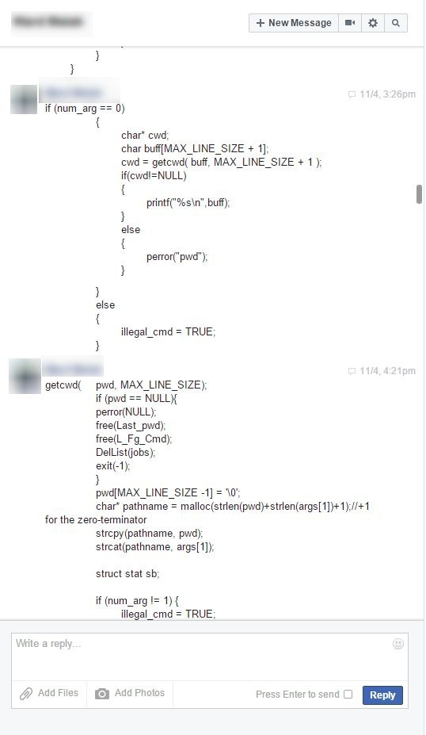
Use cases

Slide 4
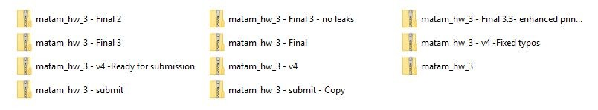
Use cases

Slide 5
Use cases
Consider this scenario:
You have a homework submission in Matam for today and the assignment is ready for submission
While testing it you discovered a minor bug and decided to fix it

Slide 6
Use cases
After attempting to do so, you accidentally changed a working code and got yourself in a big mess
You no longer remember what was and what wasn’t there
It is 23:58 PM

Slide 7

Now you realize that CTRL + Z won’t solve your
problems

Slide 8

What is git?

Slide 9

What is git?
Open source project originally developed in 2005 by Linus Torvalds
A command line utility
You can imagine git as something that sits on top of your file system and manipulates files.
A distributed version control system - DCVS

Slide 10
What is “distributed version control system” ?
Version control system is a system that records changes to a file or set of files over time so that you can recall specific versions later
Distributed means that there is no main server and all of the full history of the project is available once you cloned the project.

Slide 11
A brief history
In 2002, the Linux kernel project began using a DVCS
called BitKeeper
In 2005, the commercial company that developed BitKeeper broke down, and the tool’s free-of-charge status was revoked
This prompted the Linux development community (and in particular Linus Torvalds, the creator of Linux) to develop their own tool - git

Slide 12

Demo

Slide 13
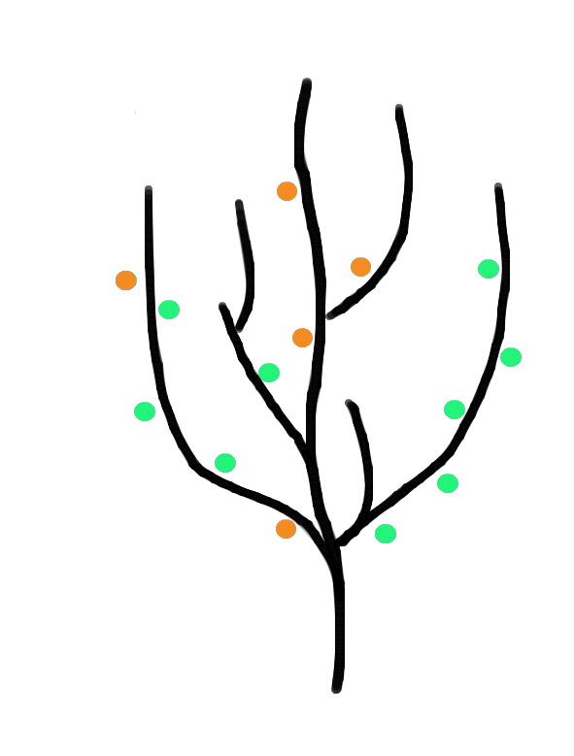


git
You can imagine git as something that sits on top of your file system and manipulates files.
This “something” is a tree structure where each commit
creates a new node in that tree.
Nearly all git commands actually serve to navigate on this tree and to manipulate it accordingly.
commit
branch

Slide 14
git repository

Slide 15
git repository
The purpose of git is to manage a project, or a set of files, as they change over time. Git stores this information in a data structure called a repository
A git repository contains, mainly:
A set of commits

Slide 16
Commit
A commit object mainly contains three things:
A set of changes the commit introduces
Commit message describing the changes
A hash, a 40-character string that uniquely identifies the commit object

Slide 17
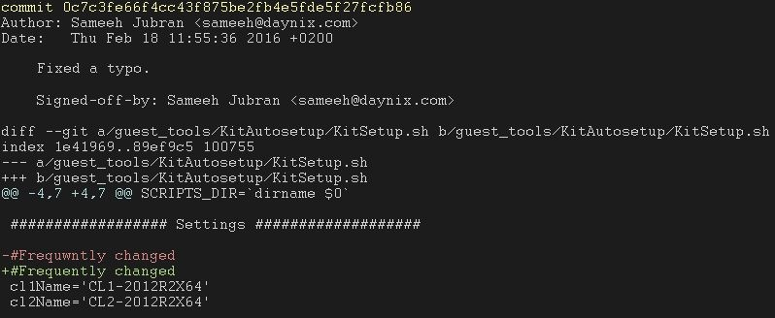
Commit
Commit id (hash)
Commit message
The change the commit introduces

Slide 18

Github

Slide 19
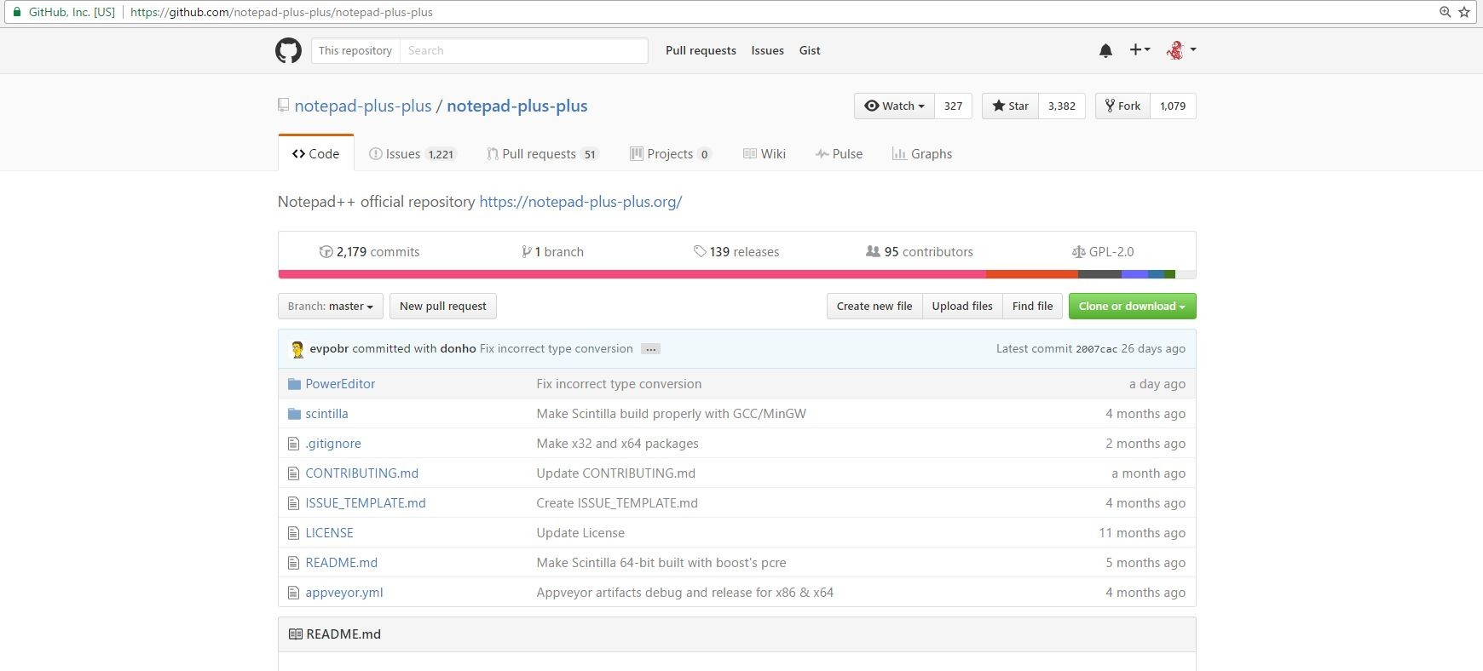
Github
GitHub is a web-based Git repository hosting service

Slide 20
git workflow
How commits are created?
Introduce changes
git add
Add the change to staging area
git commit
Make that change “permanent”

Slide 21
The three steps of git
Introduce a change: introduce a change to a file that is being tracked by git
Add the actual change to staging area: Add the change you actually want using “git add”
Commit: Commit the change that has been added using git commit
Introduce changes
git add
Add the change to staging area
git commit
Make that change “permanent”

Slide 22

Let’s create a commit

Slide 23
git commands

Slide 24
git commands
For most of the basic interactions with git you’ll mainly use 7 commands that we’ll cover here

Slide 25
git commands
git init
git clone
git log
git diff
git status
git add
git commit

Slide 26
git init
Creates a new git repository
Can be used to convert an existing, unversioned project to a git repository or initialize a new empty repository

Slide 27
git clone
Copies an existing git repository

Slide 28
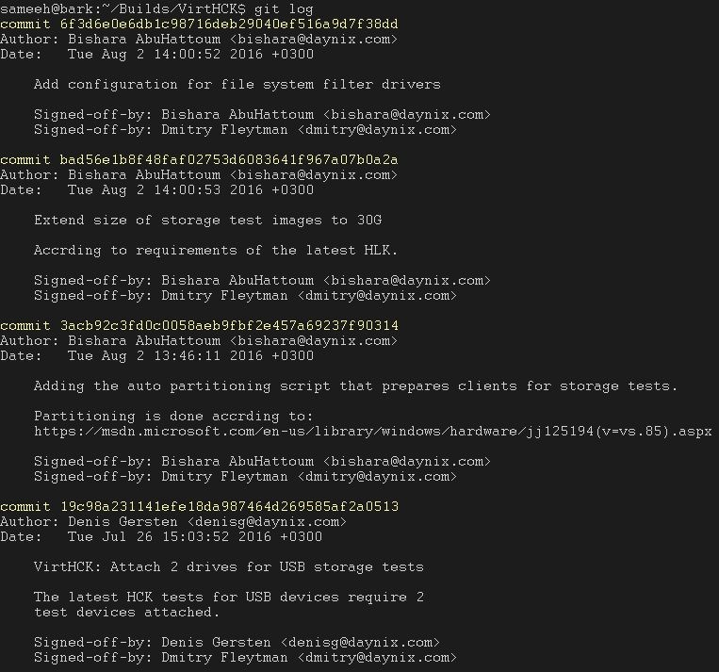
git log
Shows the commit logs

Slide 29
git add
Adds changes
Introduce a change
git add
Add the change to staging area
git commit
Make that change “permanent”

Slide 30
git commit
Creates a commit out of the changes that had been added
Introduce a change
git add
Add the change to staging area
git commit
Make that change “permanent”

Slide 31
git diff
Displays the change that was introduced
Useful flag:
--cached:
Displays the change that was added using “git add”

Slide 32
git status
Displays the file names that has been modified, added and untracked

Slide 33
Bonus command: git checkout
Checking out a commit makes the entire working directory match that commit

Slide 34

Q&A

Slide 35
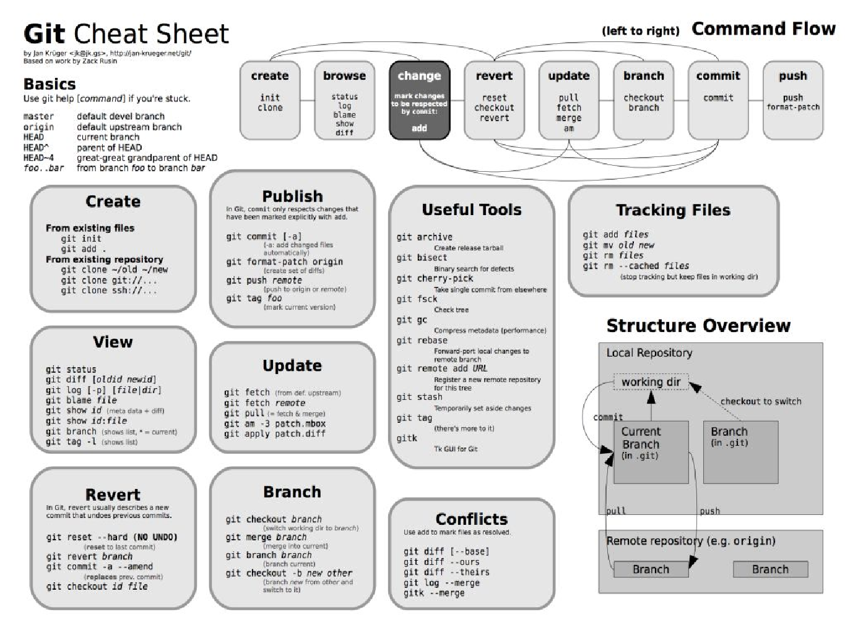
Cheat Sheet

